Slide 1
Merging and Data Clean Project
Lesson 4.3
Notes:
1.1
Welcome the class to class and let them know that today will dive into a few more functions in the pandas library and learning how to deal with multiple datasets.The end of the lesson will focus far more intently on teaching everyone how to teach themselves and bug fixing.
While this concept may sound a bit strange to the class at first, let them know that self-teaching is probably the most important skill in the programming arsenal since languages are never set in stone.
New libraries are always being developed and even core programming languages are always being updated to include new functions or syntax. As such, the master programmer must always be ready and willing to teach themselves new skills.
If students seem nervous, reassure them that self-teaching becomes much easier as time goes by. Students may have already found themselves practicing this skill without even realizing it since the best way in which to learn new techniques is to make mistakes and look up solutions online.

Slide 2
Class Objectives
By the end of today’s class you will be able to:
Merge DataFrames together whilst understanding the differences between inner, outer, left, and right merges.
Slice data using the method and create new values based upon a series of bins.
Feel more confident in the ability to fix Python/Pandas bugs within Jupyter Notebook.
Use Google to explore additional Pandas functionality.
Notes:
1.1

Slide 3
Merging DataFrames
Notes:
1.2

Slide 4
Merging DataFrames
What’s Merging?
Sometimes an analyst will receive data split across multiple tables and sources
Working across multiple tables is error-prone and confusing
Merging is the process of combining two tables based on shared data.
Shared data can be an identical column in both tables, or a shared index.
In Pandas, we can merge separate DataFrames using the pd.merge() method.
Notes:
1.2
Sometimes, the data an analyst is provided with is split into multiple parts. This, of course, is not an ideal situation as it is far more preferable to work with a single dataset than it is to work with a bunch of different datasets.
This is where the concept of merging comes into play, as Pandas allows its users to quite easily combine separate DataFrames on similar values using the pd.merge() method.
Open up 01-Ins_Merging within Jupyter Notebook and run through the code with the class, discussing it cell-by-cell.
NOTE: RUN UP TO 3rd CELL BEFORE SHOWING NEXT SLIDE
The first chunks of code are used to create two DataFrames which contain information on customers and the purchases they have made.
Make sure to point out how these two DataFrames share the "customer_id" column in common. This will be very important soon.

Slide 5
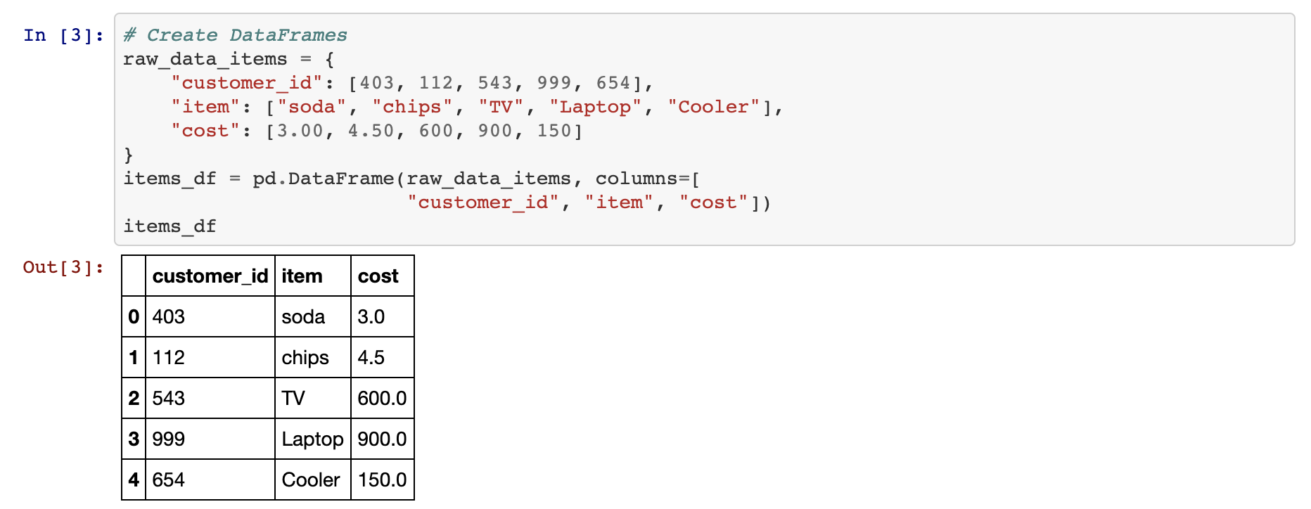
Merging DataFrames
Inner Join
Inner joins are the default means through which DataFrames are combined using the pd.merge() method and will only return data whose values match. Rows that do not include matching data will be dropped from the combined DataFrame.
Notes:
1.2
In the final chunk of code, the pd.merge() method is used and three parameters are passed into it: references to both of the DataFrames and the value on="customer_id".
This code tells the computer to combine the two DataFrames together so that, whenever the "customer_id" column matches, the rows containing the matching data are joined.
This is what is known as an inner join. Inner joins are the default means through which DataFrames are combined using the pd.merge() method and will only return data whose values match. Any rows that do not include matching data will be dropped from the combined DataFrame.

Slide 6
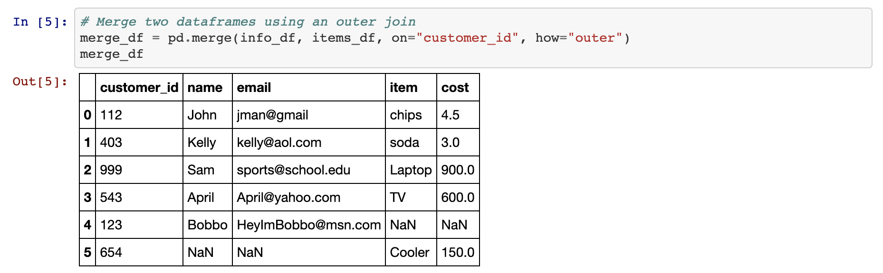
Merging DataFrames
Outer Join
Outer joins will combine the DataFrames regardless of whether any of the rows match and must be declared as a parameter within the pd.merge() method using the syntax how=’outer’.
Notes:
1.2
The opposite of an inner join is an outer join. Outer joins will combine the DataFrames regardless of whether any of the rows match and must be declared as a parameter within the pd.merge() method using the syntax how="outer".
Any rows that do not include matching data will have the values within replaced with NaN instead.

Slide 7
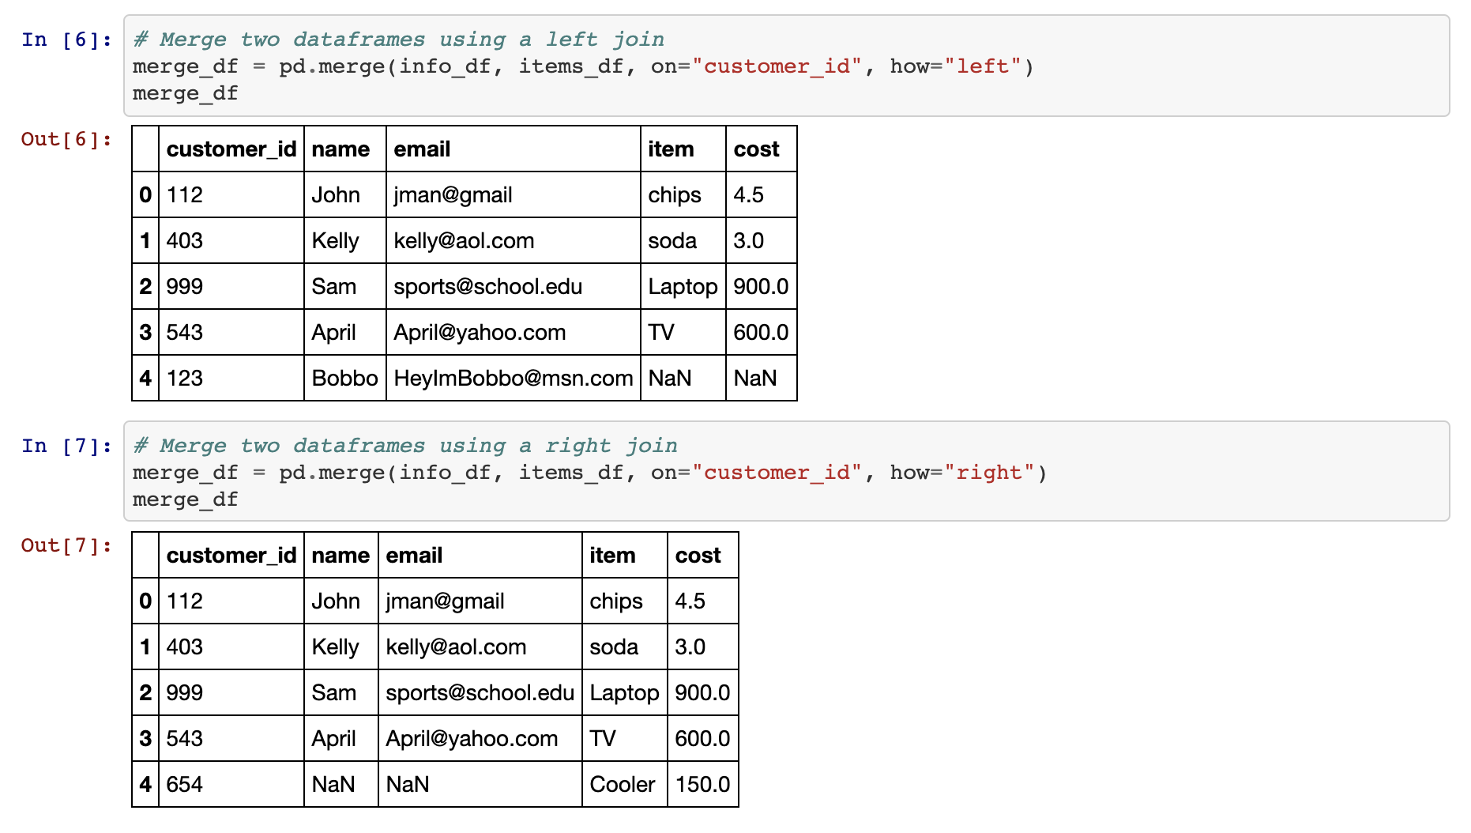
Merging DataFrames
Right and Left Joins
These joins will protect the data contained within one DataFrame like an outer join does whilst also dropping the rows with null data from the other DataFrame.
Notes:
1.2
There are also right and left joins. These joins will protect the data contained within one DataFrame like an outer join does whilst also dropping the rows with null data from the other DataFrame.

Slide 8
Activity: Cryptocurrency Merging
In this activity, you will merge two datasets on cryptocurrencies, one on Bitcoin and the other on Dash. Once fully merged you will clean it to make it more presentable.
20 Minutes
Notes:
1.3

Slide 9
Activity: Cryptocurrency Merging
Instructions:
Read in both of the CSV files and print out their DataFrames.
Perform an inner merge that combines both DataFrames on the "Date" column.
Rename the columns within the newly merged DataFrame so that the headers are more descriptive.
Create a summary table that includes the following information: Best Bitcoin Open, Best Dash Open, Best Bitcoin Close, Best Dash Close, Total Bitcoin Volume, Total Dash Volume.
Total Bitcoin Volume and Total Dash Volume should be calculated to have units of "millions" and be rounded to two decimal places.
Notes:
1.3

Slide 10
Notes:
1.4
Check lesson plan to review! Or see below:
Open up 02-Stu_Cryptocurrency within Jupyter Notebook and run through the code with the class, discussing it cell-by-cell.
Once the two DataFrames have been merged, the column headers are messed up. This is because the columns within the first DataFrame match those within the second and Pandas feels the need to differentiate them somehow. This also means the columns need to be renamed manually.
Alternatively, you can create custom suffixes by adding a suffixes = (_x,_y) argument to pd.merge. _x and _y can be replaced with any text you wish.
To find the total volumes for Bitcoin and Dash, our code divides the sum of their columns by one million and then rounds the returned value to the nearest two decimal places.
The values for our summary DataFrame are held within brackets because, without them, Pandas would have difficulties understanding that all of these values should be held within the same row.

Slide 11
Binning Data
Notes:
2.1

Slide 12


The "binning" method is an effective function that place values into groups in order to allow a more vigorous customization of datasets.
Notes:
Note: background slide from ‘data-03-3-python-deeper-dive’ slide 6, and Einstein from ‘SQLAlchemy Daya 3’ slide 8
2.1
Not everyone is a numbers person and sometimes there are so many values within a DataFrame that it becomes very difficult to comprehend what exactly is going on. For this reason, Pandas has a built-in "binning" method that allows its users to place values into groups so as to allow for more vigorous customization of datasets.

Slide 13
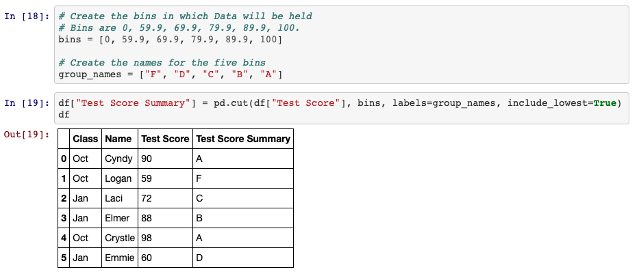
Binning Data
pd.cut()
Use pd.cut() when you need to segment and sort data values into bins. This function is also useful for going from a continuous variable to a categorical variable.
Notes:
2.1
Open up 03-Ins_Binning within Jupyter Notebook and run through the code with the class, discussing it cell-by-cell.
When using the pd.cut() method, three parameters must be passed in. The first is the Series that is going to be cut. The second is a list of the bins that the Series will be sliced into. The last is a list of the names/values that will be given to the bins.
It is important to note how, when creating the list for bins, Pandas will automatically determine the range between values. This means that, when given the list [0, 59, 69, 79, 89, 100], Pandas will create bins with ranges between those values in the list.
The labels for the pd.cut() method must have an equal length to the number of bins. If there are too many or too few, an error will be returned.

Slide 14
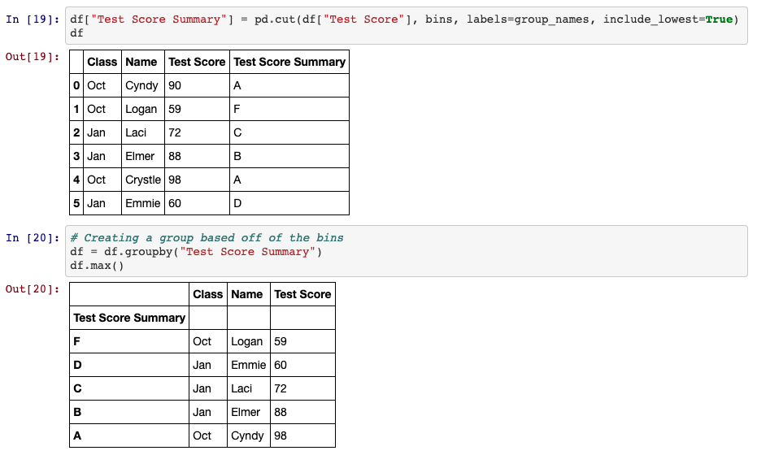
Binning Data
What makes binning so powerful is that, after creating and applying these bins, the DataFrame can be grouped according to those values and thus a higher-level analysis can be conducted.
Notes:
2.1
What makes binning so powerful is that, after creating and applying these bins, the DataFrame can be grouped according to those values and thus a higher-level analysis can be conducted.

Slide 15
Activity: Binning TED
In this activity, you will put your binning skills to the test by creating bins for TED Talks based upon their viewership.
25 Minutes
Notes:
2.2
The class will now put their binning skills to the test by creating bins for TED Talks based upon their viewership. After creating the bins, they will then group the DataFrame based upon those bins and perform some analysis on them.
Open up the solved version of 04-Stu_TedTalks within Jupyter Notebook in order to show students what the final version of their application should look like.

Slide 16
Activity: Binning TED
Instructions:
Read in the CSV file provided and print it to the screen.
Find the minimum "views" and maximum "views".
Using the minimum and maximum "views" as a reference, create 10 bins in which to slice the data.
Create a new column called "View Group" and fill it with the values collected through your slicing.
Group the DataFrame based upon the values within "View Group".
Find out how many rows fall into each group before finding the averages for "comments", "duration", and "languages".
Notes:
2.2

Slide 17
Notes:
2.3
Check lesson plan to review! Or see below:
Open up 04-Stu_TedTalks within Jupyter Notebook and run through the code with the class, discussing it cell-by-cell.
Since the values contained within the "views" column are so widespread, there are several ways in which to split up the data that would be acceptable. This particular code uses a variable scale that attempts to look at every 200k view difference until reaching the millions, at which point it switches to look at every 1mil difference.
The bins are added into the DataFrame by simply placing them within a new column. The DataFrame is then grouped on this new column in order to perform all of the Data Functions.

Slide 18
Mapping
Notes:
3.1

Slide 19
Similar to Excel’s number formats, Pandas unlocks the same functionality using the df.map() method, thus allowing users to style columns wholesale.
Notes:
Note: background slide from ‘data-03-3-python-deeper-dive’ slide 6, and Einstein from ‘SQLAlchemy Daya 3’ slide 8
3.1
Students may recall how Excel's number formats allows its users to change the styling of columns without much effort. Pandas also includes this functionality through its df.map() method, thus allowing users to style columns wholesale.

Slide 20
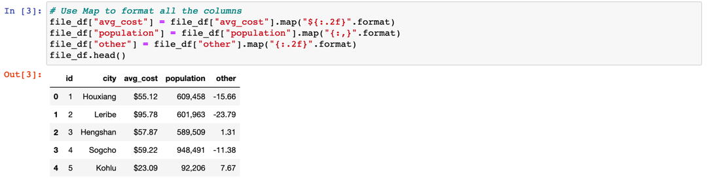
Mapping
df[<COLUMN>].map(<FORMAT STRING>.format) is the method by which users can modify the styling of an entire column.
To convert values into a typical dollar format, use "${:.2f}". This places a dollar sign before the value which has been rounded to two decimal points.
Using "{:,}" will split a number up so that it uses comma notation.
Notes:
3.1
Open up 05-Ins_Mapping within Jupyter Notebook and run through the code with the class, discussing it cell-by-cell.
df[<COLUMN>].map(<FORMAT STRING>.format) is the method by which users can modify the styling of an entire column.
The formatting syntax used for mapping is, in a word, confusing. It uses strings containing curly brackets in order to determine how to style columns and this can make it rather difficult to understand at first glance.
A somewhat easy way to understand mapping strings is that it is almost akin to concatenating strings. Whatever is outside of the curly brackets is added before/after the initial value which is modified by whatever is contained within the curly brackets.
So, to convert values into a typical dollar format, one would use "${:.2f}". This places a dollar sign before the value which has been rounded to two decimal points.
Using "{:,}" will split a number up so that it uses comma notation. For example: the value 2000 would become 2,000 using this format string.

Slide 21
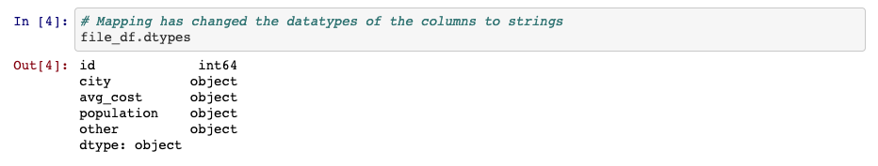
Mapping
Format mapping only really works once and will return errors if the same code is run multiple times without restarting the kernel. Because of this, formatting is usually applied near the end of an application.
Format mapping also can change the datatype of a column. As such, all calculations should be handled before modifying the formatting.
Notes:
3.1
Format mapping only really works once and will return errors if the same code is run multiple times without restarting the kernel. Because of this, formatting is usually applied near the end of an application.
Format mapping also can change the datatype of a column. As such, all calculations should be handled before modifying the formatting.

Slide 22
Activity: Cleaning Kickstarter
In this activity, you will take a dataset similar to your first homework, clean it up, and format it.
30 Minutes
Notes:
3.2

Slide 23
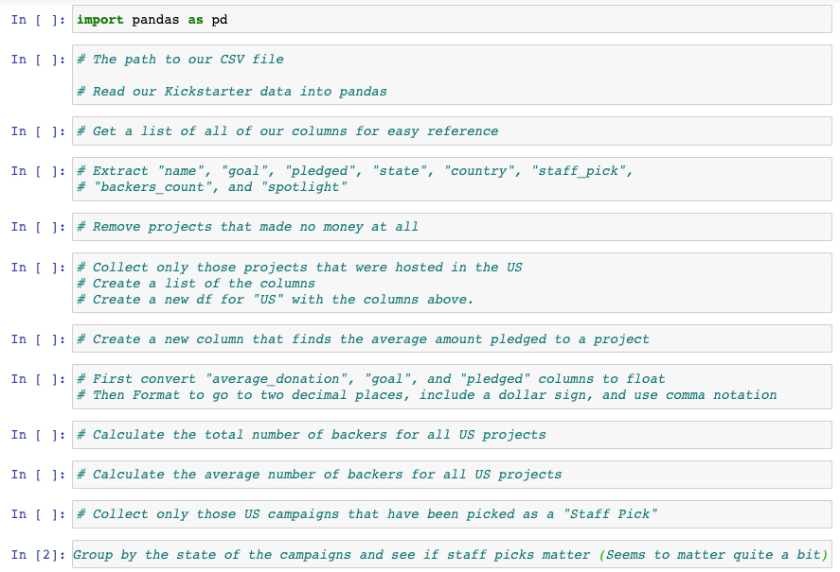
Activity: Cleaning Kickstarter
Instructions:
The instructions for this activity are contained within the Jupyter Notebook.
Notes:
3.2
Open up the solved version of 06-Stu_CleaningKickstarter within Jupyter Notebook in order to show students what the final version of their application should look like.

Slide 24
Notes:
3.3
Check lesson plan to review! Or see below:
⏰3-Hour Adjustment: This review activity is now an Everyone Do.
Spend only 30 minutes on this activity.
Use the review section as guidance for talking points as you live-code along with the students.
Be sure to take your time and answer all student questions along the way.
Open up 06-Stu_CleaningKickstarter within Jupyter Notebook and run through the code with the class, discussing it cell-by-cell.

Slide 25

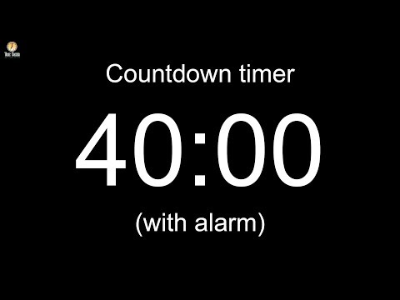
Notes:
Leave slide running during the break!
NOTE : In case needed due to the hour adjustment, fast forward the video timer and start the countdown at 25 minutes!
Image source: AdobeStock_56885471

Slide 26
Intro to Bugfixing
Notes:
4.1

Slide 27
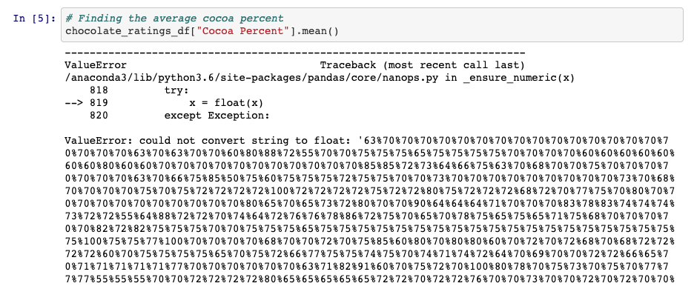
Bugfixing Bonanza
Note that an error is being returned as the application attempts to collect the average value within the "Cocoa Percent" column.
Notes:
4.1
Open up 07-Ins_IntroToBugfixing within Jupyter Notebook and slack the code out to the class as well. Make certain to send flavors_of_cacao.csv out to the class as well.
Point out to the class how, within the third block of code, an error is being returned as the application attempts to collect the average value within the "Cocoa Percent" column.
Many within the class likely already know what the bug within this block of code is - the values within the column are strings and it is not possible to collect the mean of a string - but tell them to hold off on pointing this out for now.

Slide 28
Bugfixing Bonanza
The First Step: Keep Calm
Bugs happen all the time and they are rarely the end of the world. In fact, most bugs that programmers run across are simple enough to solve so long as they know how and where to look for the solution.
Notes:
4.1
The first step in fixing a bug is to keep calm.
Bugs happen all the time and they are rarely the end of the world. In fact, most bugs that programmers run across are simple enough to solve so long as they know how and where to look for the solution.

Slide 29
Bugfixing Bonanza
The Second Step: Figure out what the bug is and where it is located
In Jupyter Notebook is quite easy to find the erroneous block of code since the error will always be returned in the space beneath the erroneous cell.
Unfortunately Pandas is not known for returning clearly understandable error text. In fact, it often returns large blocks of text that is complex and confusing to those who do not know the library's underlying code. Looking for the line following KeyError: is generally a good starting point.
For example, the text following TypeError: within the current code lets the programmer know that Pandas cannot convert the string values in the "Cocoa Percent" column to floats.
If the error text is not entirely clear, it is oftentimes helpful to print out variables/columns to the console in order to uncover where the bug is. For example, printing out the "Cocoa Percent" series lets the programmer know that the dtype of this series is an object and not a float.
Notes:
4.1
The second step to bugfixing an application is to figure out what the bug is and where it is located.
Since the class is using Jupyter Notebook at this point in time, it is quite easy to find the erroneous block of code since the error will always be returned in the space beneath the erroneous cell.
Unfortunately Pandas is not known for returning clearly understandable error text. In fact, it often returns large blocks of text that is complex and confusing to those who do not know the library's underlying code. Looking for the line following KeyError: is generally a good starting point.
For example, the text following TypeError: within the current code lets the programmer know that Pandas cannot convert the string values in the "Cocoa Percent" column to floats.
If the error text is not entirely clear, it is oftentimes helpful to print out variables/columns to the console in order to uncover where the bug is. For example, printing out the "Cocoa Percent" series lets the programmer know that the dtype of this series is an object and not a float.

Slide 30
Bugfixing Bonanza
The Third Step: To look up the error online and source for solutions
The key part to this step is coming up with an accurate way to describe the bug. This may take multiple tries and is a skill that will develop over time.
Google is the programmer's best friend as typing in a description of the bug being faced will often bring up links to some possible solutions. If not, simply change the search up a little bit until a solution is discovered.
This particular problem requires the code to drop the percentages within the "Cocoa Percent" column, so the search should be a bit more specific.
Notes:
4.1
The third step is to look up the error online and search for solutions that other programmers have uncovered.
The key part to this step is coming up with an accurate way to describe the bug. This may take multiple tries and is a skill that will develop over time.
Google is the programmer's best friend as typing in a description of the bug being faced will often bring up links to some possible solutions. If not, simply change the search up a little bit until a solution is discovered.
This particular problem requires the code to drop the percentages within the "Cocoa Percent" column, so the search should be a bit more specific.
The first link takes the class to a StackOverflow question which asks how to drop percentages and convert a column to floats. This provides an answer to the bug.
Feel free to copy and paste the solution and then modify it within Jupyter Notebook. Let the class know that copying and pasting from StackOverflow is something almost every single programmer does.

Slide 31
Activity: Bugfixing Bonanza
In this activity, you will be provided with a Pandas project containing TONS of bugs inside of it. Your job will be to take the application and fix it up so that it works properly.
35 Minutes
Notes:
4.2

Slide 32

Activity: Bugfixing Bonanza
Instructions:
Dig through the Jupyter Notebook provided and attempt to fix as many bugs as possible. There are a lot of them and the bugs get harder to deal with as the code progresses.
Once you have finished bugfixing, perform some additional analysis on the dataset provided. See what interesting trends are buried deep within these bug logs for the Eclipse IDE. So long as you challenge yourself, bugs will pop up and you will get even more bugfixing practice.
Hints:
After fixing the bugs in each block of code, be sure to run the cell below for an updated error.
There are a few new concepts being covered within this Jupyter Notebook. The most complex of these concepts is that of multi-indexing and it is very likely that this is where many will get held up. Do not worry though, multi-indexing is not in the homework and is not required outside of this activity. It is simply an interesting/powerful feature of Pandas.
Notes:
4.2

Slide 33
Notes:
4.3
Check lesson plan to review! Or see below:
⏰3-Hour Adjustment: This review activity is now an Everyone Do.
Spend only 28 minutes on this activity.
Use the review section as guidance for talking points as you live-code along with the students.
Be sure to take your time and answer all student questions along the way.
Open up 08-Stu_BugfixingBonanza within Jupyter Notebook and run through the code with the class, discussing it cell-by-cell.
Whoever wrote this code originally is not very good at their job... But it is a sad fact of life that many programmers out there are not exceptionally good at crafting clean code. As such, it is extremely helpful to practice bugfixing as much as possible.
The first bug is rather simple. No dependencies have been declared and, as such, the application will not be able to use Pandas.
The second bug is also pretty simple. The CSV is being read in but it is not being saved to a DataFrame.
The third bug is where things start getting complex. For whatever reason, Pandas does not seem to be able to collect data from the "Number of Comments" column. This is because the column header includes new lines inside of it. The columns will need to be renamed to fix this.
The fourth/fifth bugs are another step up in difficulty as the assignee_group DataFrame has two indexes. The first is the "Assignee" and the second is the "Component". While this makes for a nicely organized DataFrame, it creates problems later on.
In order to collect the correct values for total_bugs, the application must count the "Assignee" column of the initial DataFrame while bugs_per_user should count the "Assignee" column of the GroupBy object. The series should then be converted into a DataFrame for merging later on.
It is not possible to merge DataFrames on indexes. As such, both of the DataFrames need to have their indexes reset so that it is possible to merge on the "Assignee" column. If this is not done, incorrect data will be used, an error will be returned, or only some rows will be filled.

Slide 34


last
but
not least..
Notes:
4.4
Before finishing up for the night, slack out the Video Guide containing walkthroughs of this week's key activities. Encourage students to review them later and utilize office hours if they have further questions.

